Slide 1

Oauth Database
Tommy Hall, Lance Diakite
Oauth – Open Authentication

Slide 2
Choice of Topic
Business and Personal Use Case
Flexible in Implementation
Aligned with Team Focuses

Slide 3
Use Case
Many large scale software companies implement there own Oauth solutions that developers use in their applications. This allows people to have a schema for there own Oauth solution on a smaller scale with less of the higher level requirements for a full scale solution. Good for medium to small sizes companies and individual developers.
Business | Community (Personal)
Managing Secure Access of Endpoints | Securing Software for Singular or Distributed Use
Managing Roles Through Secure Practices | Managing Different Permissions of System
Built in Action Monitoring for Log Auditing | Allows Secure Remote Connection with Security
Easy Scaling of Access for Different Departments

Slide 4
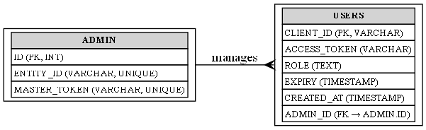
E-R Model

Slide 5
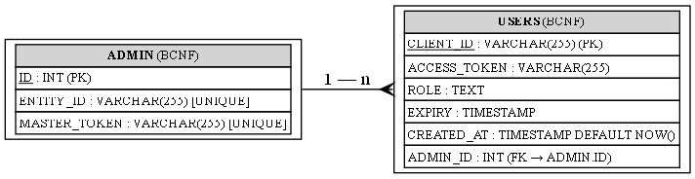
Schema Examples

Slide 6
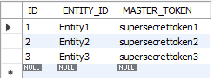
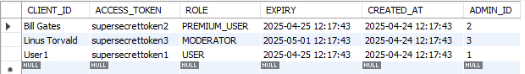
Database Schema and Data
ID’s: Each admin has a unique primary key ID which each user references. Users have a unique string ID (Username). The Entity ID is used to link a master token to a specific admin entity for logging.
Tokens: Used to manage access to credentials and are set up by the implementer of the database. Master tokens do not have a time to live (TTL) access tokens are used for the client and have a TTL.
Role: Used for access portability, different users can all have the same access token but with different access roles.
Timestamps: Every-time a user is created it is logged when they are created and an expiry is generated a day after its creation meaning users can only stay authenticated for a day before having to be redistributed a new credential set in the system.

Slide 7
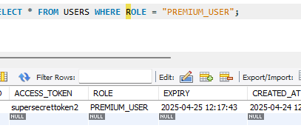
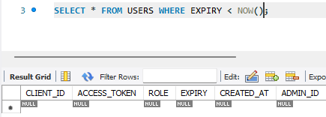
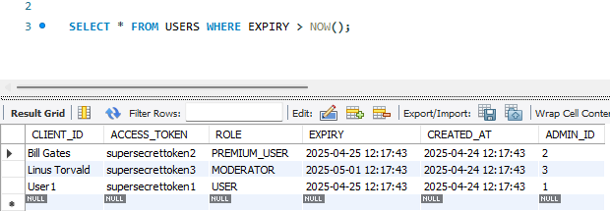
SQL Queries

Slide 8
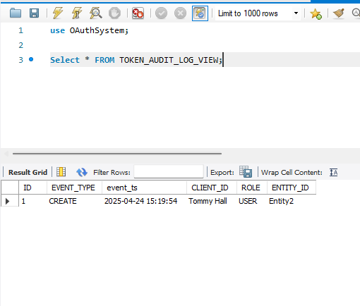
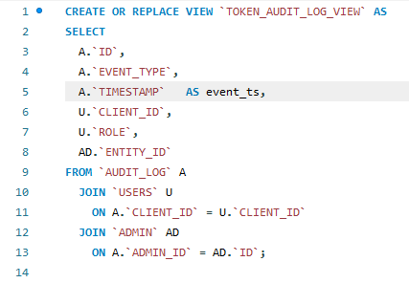
SQL Views

Slide 9
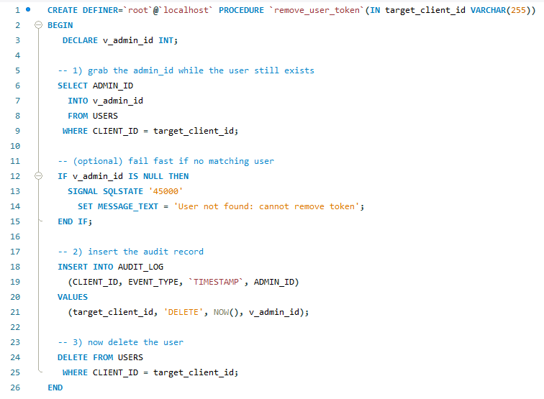
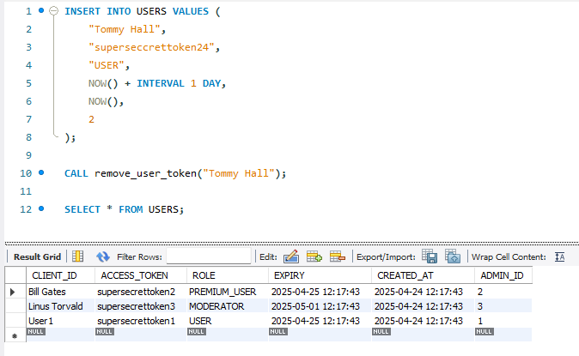
SQL Procedures

Slide 10
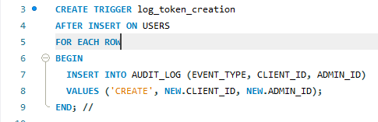
SQL Triggers
Whenever a user is added it is logged in the audit log to ensure that all creations are accounted for

Slide 11
Issues
Client cannot currently configure expiry time
Client cannot manage user access roles as these are predefined
To refresh clients there will have to be a system for this setup by the client as the design does not handle it automatically

Slide 12
Future Features
Refresh token for access token
Scope table for each role to easily handle access
Revocation table keeps revoked keys to check against new ones
Extended Logging (refresh, revocation, failed validation, IP addresses, etc.)
Per-user configuration of token lifetime, scopes, and consent policies

